Slide 2
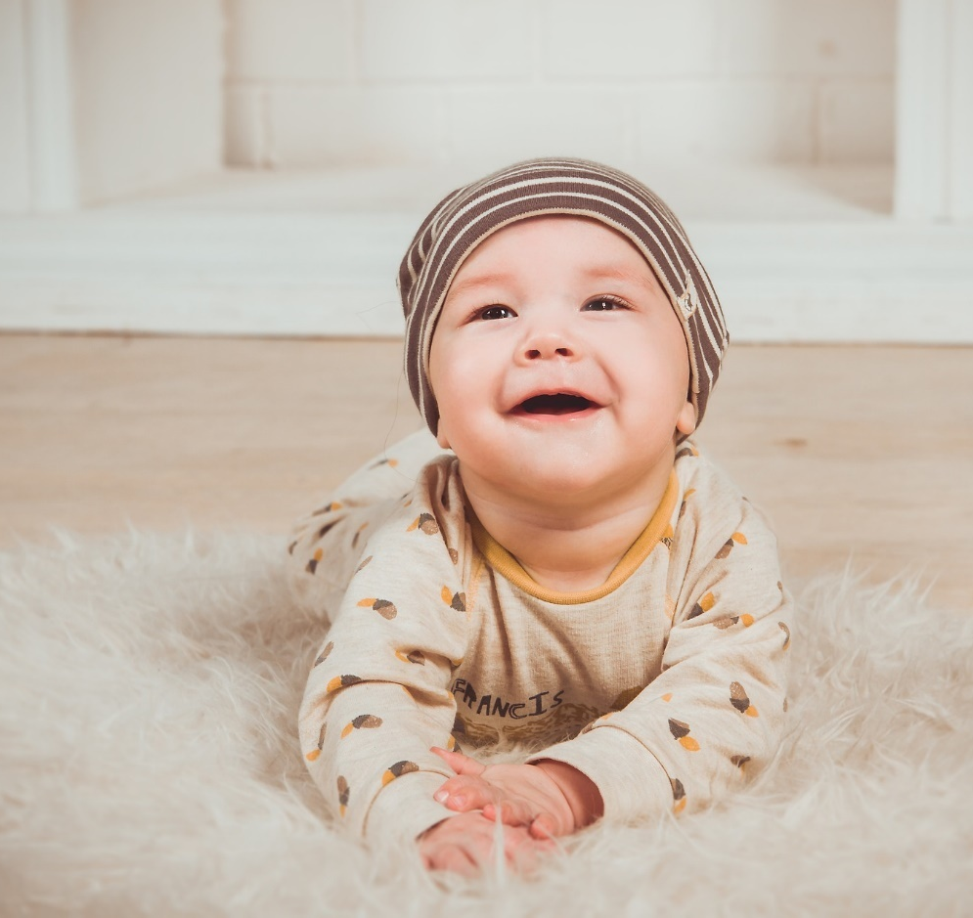
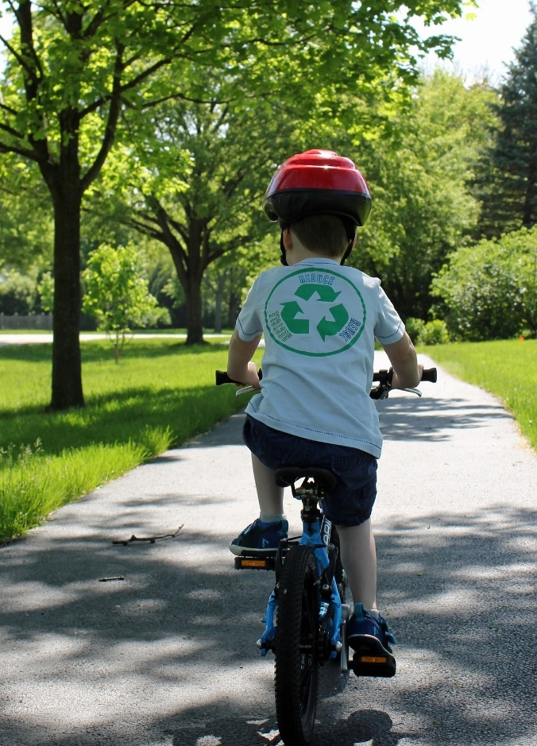
Important Dates and Events in My Life

Slide 3
Why is it important to look back at important dates and events in our lives?
You have had some very important events in your life so far.
Even though you may not remember most of them, they are very special to you and your family.

Slide 4
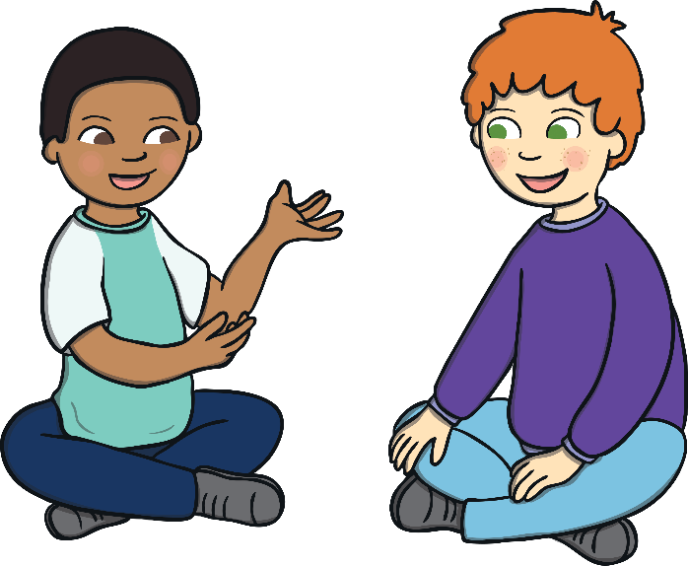
Think – Pair – Share
Can you think of any very important dates or events in your life so far?
Discuss them with the student beside you, then share with the class!

Slide 5
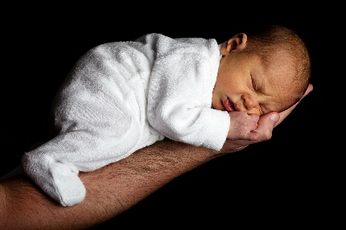
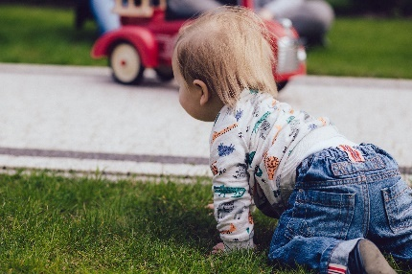
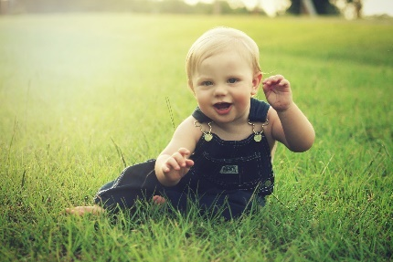
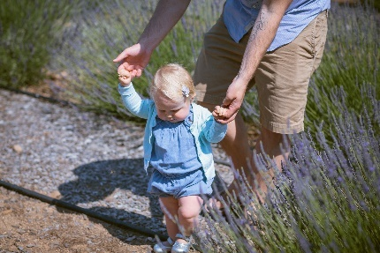
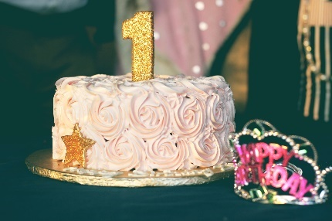
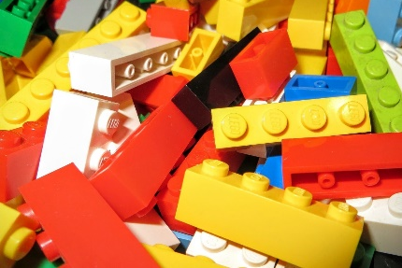
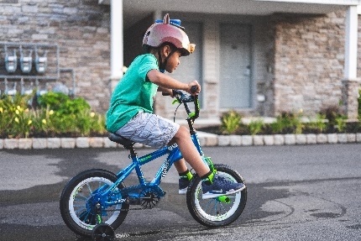
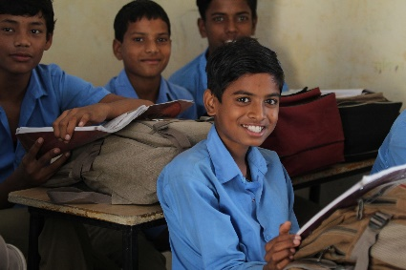
Let’s have a look at some important dates and events in our lives.
Click on the images below to have a look at some of the important dates and events in our lives.

Slide 6
The Day You Were Born
This was a very important day for your family. You entered into their world and everything changed.
Were you the first baby born in your family?
Were you a new baby brother to your siblings?
Were you a new baby sister to your siblings?
Share your birthday with your class – is there anyone that was born on the same day as you?
You needed a lot of care when you were born and your parents and family would have been very busy taking care of you.
What do parents have to do for a newborn baby?
Back

Slide 7
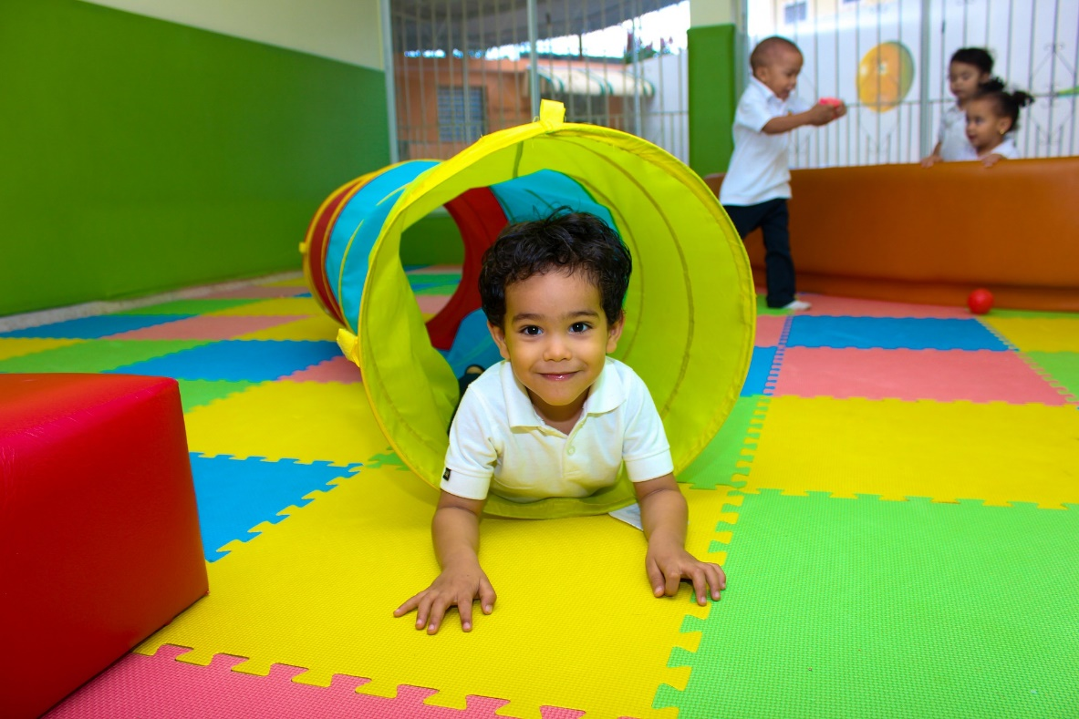
Crawling
After a few months, you became stronger and you were able to sit up.
Some babies start crawling as young as 6 months! Not all babies crawl at the same time. It might be later for others.
Things would have become extra busy for your family, keeping an eye on you at all times.
Maybe you can ask the adults at home what age you were when you started to crawl.
Back

Slide 8
Your First Word
When a baby says their first word, it can be a very exciting time for their family!
Can you guess what the most common first word is?
Go to the next slide when you are ready to find out!
Next

Slide 9
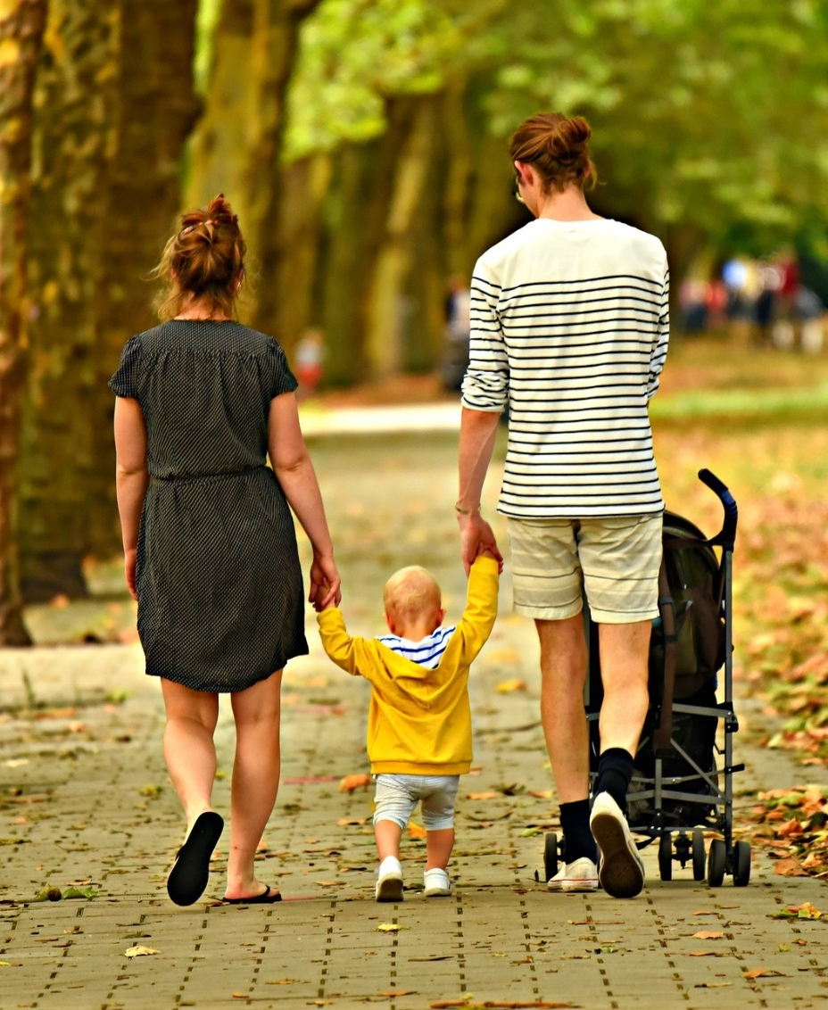
Research Results
Research shows that the most common first baby word is…
‘Dada’ or ‘Daddy’
Next is ‘Mama’ or ‘Mammy’.
Do you know what your first word was?
Back

Slide 10
Your First Step
Imagine how excited a baby is when they are taking their first ever step!
Before this happens, most babies learn how to balance and stand up by themselves.
Everyone must have been very busy keeping an eye on you!
Once a baby starts walking, they find it much easier to get around. It must feel great to be able to go get your favourite toy all by yourself, without any help.
Back

Slide 11
Your First Birthday
Your first birthday is another event that you may not remember. Why not ask at home if there are any photos of your first birthday?
This was another special day of celebrating with your family and friends.
Maybe you were scared when everyone sang ‘Happy Birthday’ to you for the first time?
I wonder who blew out your candle with you?
Back

Slide 12
Your First Day at Preschool
Eventually, it was time for you to start preschool.
This was a very important day in your life. However, it might have been a little upsetting for you while you got used to spending time at school, away from your family.
Maybe you met your first friend at preschool?
With so many toys, books and other children to play with, we’re sure you had a great time!
Back

Slide 13
Your First Bicycle
Many children love to ride their bicycle.
We all learn how to ride a bicycle at different stages – it is quite tricky at the start!
Maybe you have already learned how to ride a bicycle?
Back

Slide 14
Your First Day of Primary School
What can you remember about your first day in Junior Infants?
When was it?
Who did you sit beside?
Are you in the same school today?
Who was your teacher?
What did you do that day?
Did you have fun?
What age were you when you started Junior Infants?

Slide 15
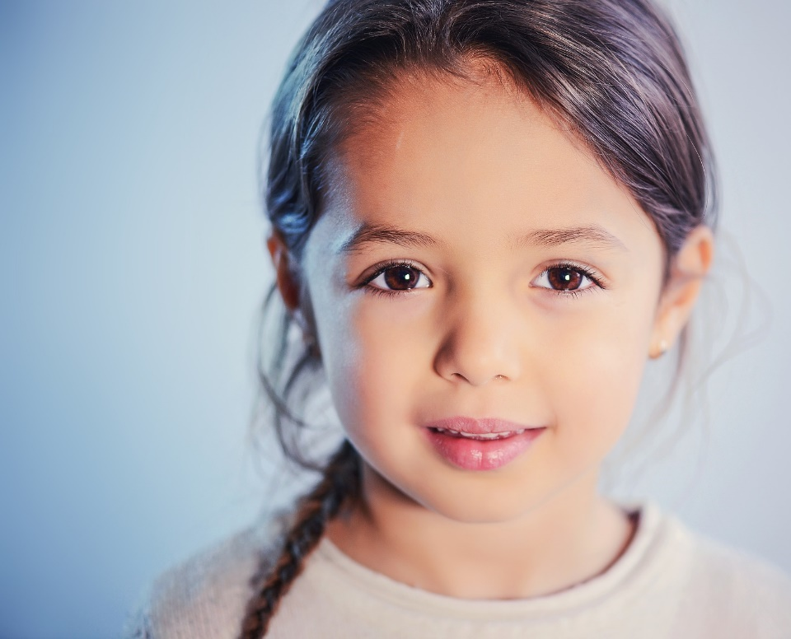
These are just some of the very important dates and events in your life.
Of course, there are many more to come.
Why not explore some artefacts from your past to learn more about how far you have come?
Looking at photographs and baby books and speaking to your family are great ways to learn about yourself.

