Slide 2
Irish Schools in the Past
Examine the images in this PowerPoint to see what Irish schools were like in the past.
See if you notice any similarities or differences between then and now.

Slide 3
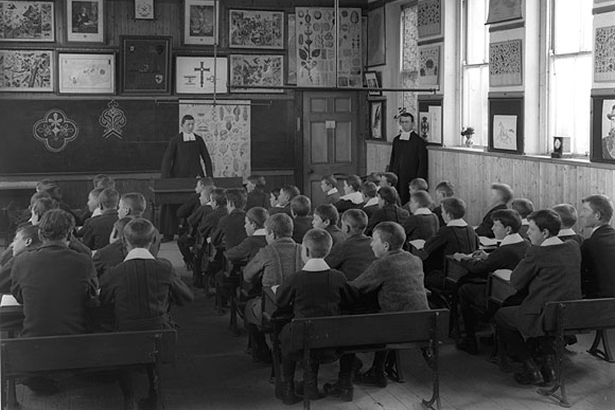
This photo was taken in a school in Waterford in the early 1900s.
How many boys can you see in the classroom in this picture?

Slide 4
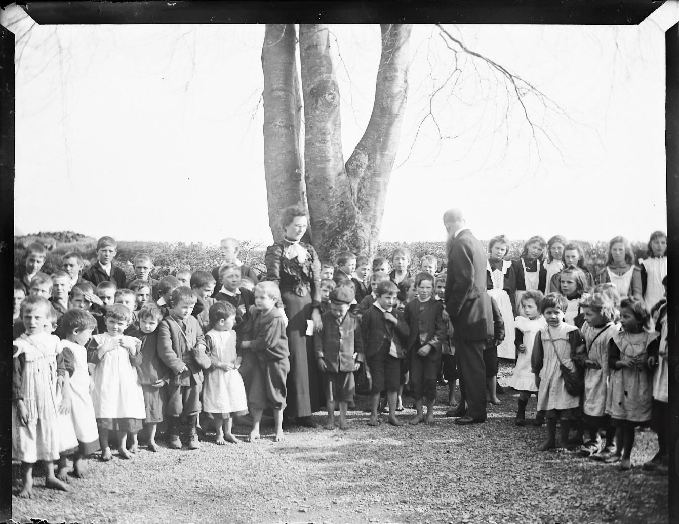
This photo shows children in Galway with their two teachers.
This photo dates back to approx. 1902.

Slide 5
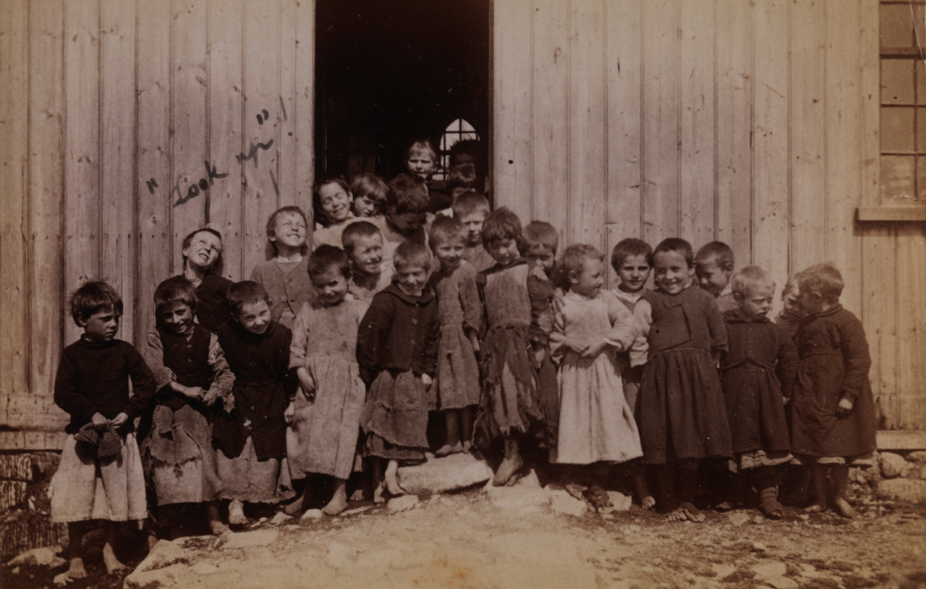
A group of boys outside a school in Connemara around 1890.
Do you notice anything interesting in this photo?

Slide 6
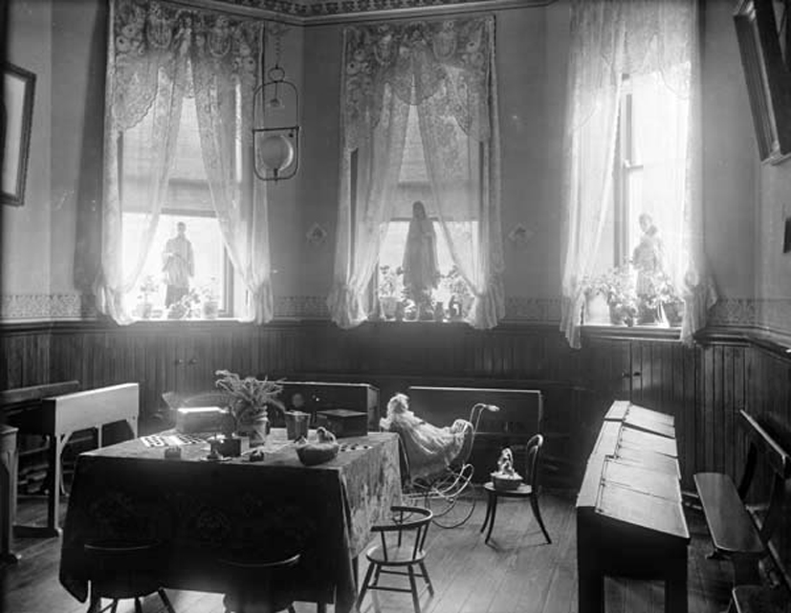
A photo of a Wexford classroom.
This photo was taken around the year 1900.
How is the furniture in this classroom different to your classroom?

Slide 7
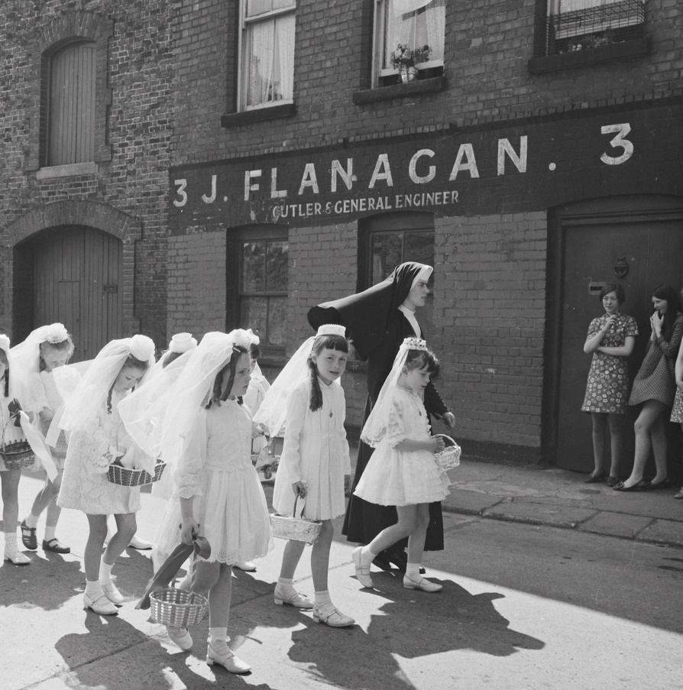
In this photo we can see a nun walking with first communion children across a road in Dublin.
This photo was taken in 1969.

Slide 8
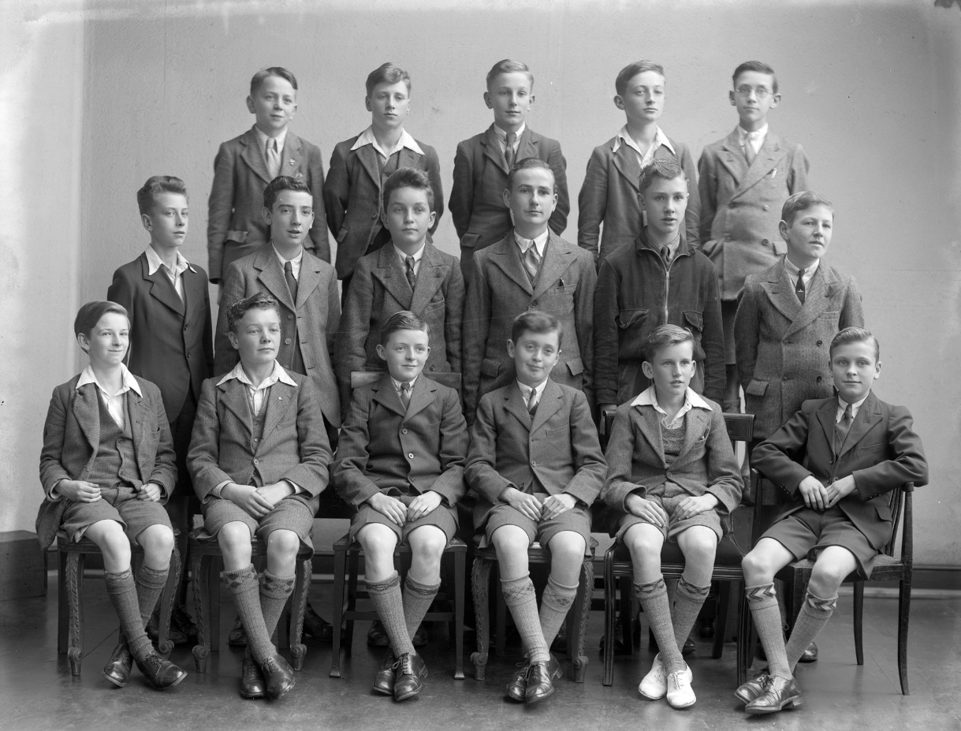
This class photo of a group of Dublin boys was taken in 1941.
How are their uniforms different to uniforms today?

