Slide 1
Maths
Statistics
Maths | Year 6 | Statistics | Interpret and Construct Charts and Graphs | Lesson 4 of 6 : Café Pie Charts

Slide 3
Aim
I can read and interpret pie charts.
Success Criteria
I can describe how data is presented in a pie chart.
I can use fractions to answer questions about data presented in a pie chart.
I can reason about data represented in pie charts.

Slide 4
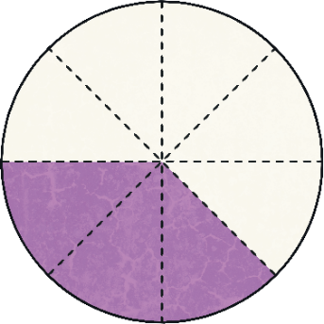
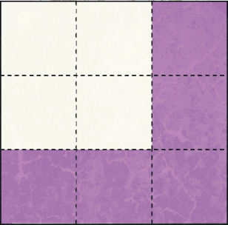
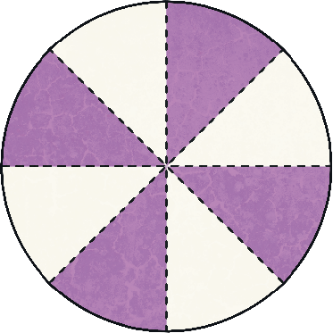
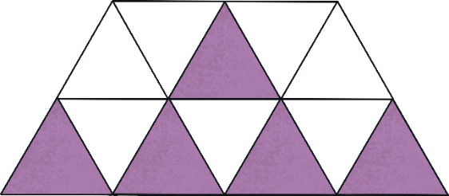
Fractions of Shapes
What fraction of each shape has been shaded?
3
8
5
9
2
7
5
12
4
6
2
3
4
8
1
2
or
or

Slide 5
Cafe Pie Charts
A pie chart is a good way of comparing the values of categorical data.
I asked twenty children in my class how often they eat at the local cafe. Here is a pie chart to show the results.
Categorical data is data that consists of two or more categories that cannot be ordered. For example, hair colour is a categorical variable as there are two or more categories (blonde, brown, black, red, etc.) and there is no way to order these from highest to lowest.
Every day
Once a week
Kamil
Never

Slide 6
Cafe Pie Charts
A pie chart is a good way of comparing the values of categorical data.
I asked twenty children in my class how often they eat at the local cafe. Here is a pie chart to show the results.
The complete circle of a pie chart always represents the total value of all the categories.
These are the only categories the children could choose from, so every answer given is represented in the full circle.
Every day
Once a week
Kamil
Never

Slide 7
Cafe Pie Charts
A pie chart is a good way of comparing the values of categorical data.
I asked twenty children in my class how often they eat at the local cafe. Here is a pie chart to show the results.
Each segment shows the proportional value of each category.
This means that the bigger the segment, the more times that category was chosen. The smaller the segment, the fewer times that category was chosen.
Every day
Once a week
Kamil
Never

Slide 8
Cafe Pie Charts
A pie chart is a good way of comparing the values of categorical data.
I asked twenty children in my class how often they eat at the local cafe. Here is a pie chart to show the results.
Notice the key, or legend, which explains what each segment relates to.
This is the part of the pie chart that shows which category each colour or pattern in the pie chart represents.
Every day
Once a week
Kamil
Never

Slide 9
Cafe Pie Charts
We can use our understanding of fractions to help us find out the value of each segment.
In this pie chart, we know that 20 children were asked how often they eat at the local cafe.
We can see that the ‘once a week’ segment is of the whole pie.
We can calculate that of 20 = 10, so we know that 10 children eat at the local cafe once a week.
1 2
1 2
Every day
Once a week
Never

Slide 10
Cafe Pie Charts
We can use our understanding of fractions to help us find out the value of each segment.
We can see that the ‘every day’ segment is of the whole pie.
We can calculate that of 20 = 5, so we know that 5 children eat at the local cafe every day.
1 4
1 4
Every day
Once a week
Never

Slide 11
Cafe Pie Charts
We can use our understanding of fractions to help us find out the value of each segment.
We can see that the ‘never’ segment is of the whole pie.
We can calculate that of 20 = 5, so we know that 5 children never eat at the local cafe.
1 4
1 4
Every day
Once a week
Never

Slide 12
Cafe Pie Charts Questions
Use your understanding of fractions to answer questions about these pie charts:
I asked 24 children in my sister’s class how often they eat at the cafe. How many answered ‘never’?
¼ of 24 = 6
so 6 children never eat at the cafe.
Every day
Kamil
Once a week
Never

Slide 13
Cafe Pie Charts Questions
Use your understanding of fractions to answer questions about these pie charts:
I asked 40 children in KS2 how often they eat at the local cafe. How many answered once a month?
1 8
of 40 = 5
so 5 children eat at the cafe once a month.
Kamil
Every day
Once a week
Never
Once a month

Slide 14
Cafe Customers Pie Charts
Monday
We can also use our understanding of fractions to help us find out how many customers went to the cafe on each day.
Tuesday
Wednesday
Thursday
We know that the whole pie chart represents the 120 customers who were served in total over the five days.
We can see that the Monday segment of the pie chart is of the whole pie.
We can calculate that of 120 = 30, so we know that 30 customers were served on Monday.
Friday
1 4
1 4
The cafe owner told me that the cafe had served 120 customers from Monday to Friday. Here is a pie chart to show how many customers they served each day.

Slide 15
Cafe Customers Pie Charts
We can also use our understanding of fractions to help us find out how many customers went to the cafe on each day.
We can see that the Wednesday, Thursday and Friday segments of the pie chart are $\frac{\text{1}}{\text{8}}$ of the whole pie each.
We can calculate that $\frac{\text{1}}{\text{8}}$ of 120 = 15, so we know that 15 customers were served each day on Wednesday, Thursday and Friday.
Monday
Tuesday
Wednesday
Thursday
Friday

Slide 16
Cafe Customers Pie Charts
We can also use our understanding of fractions to help us find out how many customers went to the cafe on each day.
We can see that the Tuesday segment of the pie chart is $\frac{\text{3}}{\text{8}}$ of the whole pie.
We can calculate that $\frac{\text{3}}{\text{8}}$ of 120 = 45,
so we know that 45 customers were served on Tuesday.
Monday
Tuesday
Wednesday
Thursday
Friday

Slide 17
Cafe Customers Pie Charts Questions
Use your understanding of fractions to answer questions about these pie charts:
The cafe served 160 customers from Monday to Friday. How many did they serve on Tuesday?
⅛ of 160 = 20 so ⅜ of 160 = 60
60 customers were served on Tuesday.
Monday
Tuesday
Wednesday
Thursday
Friday

Slide 18
Cafe Customers Pie Charts Questions
Use your understanding of fractions to answer questions about these pie charts:
The cafe served 72 customers from Monday to Friday. How many did they serve on Wednesday?
Could you have used a different fraction to work this out?
of 72 = 12
so of 72 = 24
24 customers were served on Wednesday.
1
6
2
6
2 6
1 3
is equivalent to . You could have worked out of 72 which would still give the answer 24.
1 3
Monday
Tuesday
Wednesday
Thursday
Friday

Slide 19
Cafe Customers Pie Charts Questions
Use your understanding of fractions to answer questions about these pie charts:
The cafe served 250 customers from Monday to Friday. How many did they serve on Thursday?
$$\frac{\text{1}}{\text{10}}$$
of 250 = 25
so of 250 = 75
75 customers were served on Thursday.
1
10
3
10
Monday
Tuesday
Wednesday
Thursday
Friday

Slide 20
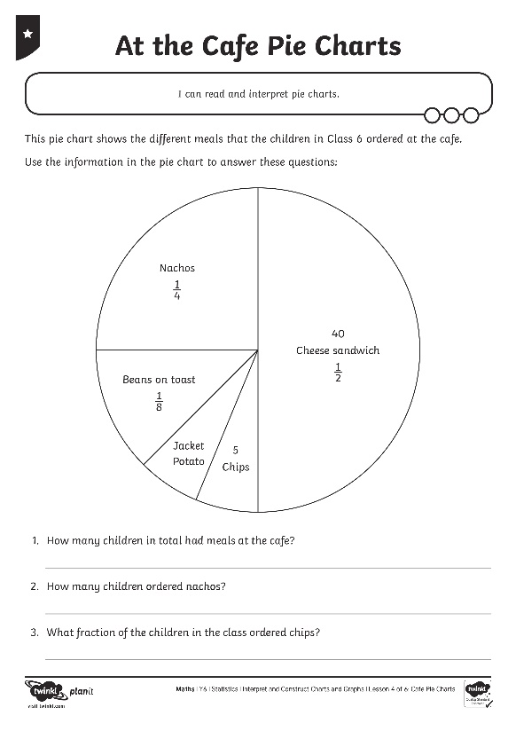
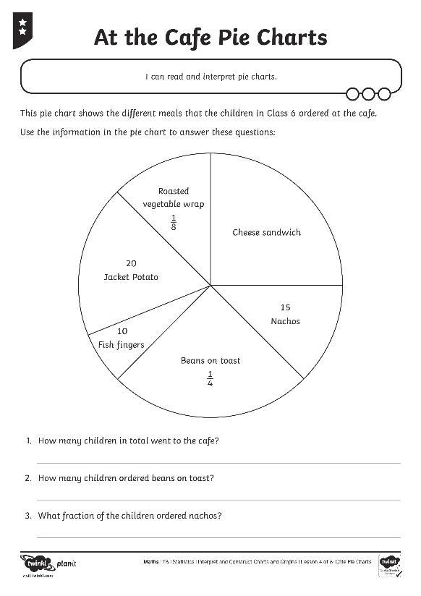
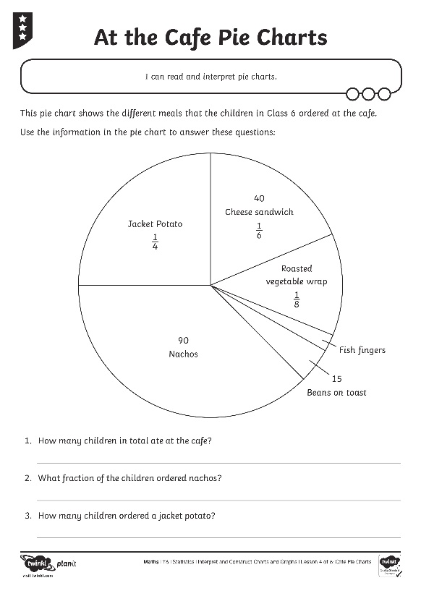
At the Cafe Pie Charts

Slide 21
Pie Chart Reasoning
The cafe owner wants to add a new item to the lunch menu. She asks some of her customers which dish they would prefer. The results are shown in this pie chart.
Menu…
Chicken nuggets
24 people voted for red lentil curry.
How many people in total did the cafe owner ask?
Explain your reasoning to your partner.
Red lentil curry
Egg and chips
Halloumi wrap

Slide 22
Pie Chart Reasoning
The cafe owner asked 96 people in total.
Menu…
Chicken nuggets
Red lentil curry is a quarter of the whole pie chart.
There are four quarters in a whole, so to find the total number of people, we need to multiply 24 by 4.
24 × 4 = 96
Red lentil curry
Egg and chips
Halloumi wrap

Slide 23
Aim
I can read and interpret pie charts.
Success Criteria
I can describe how data is presented in a pie chart.
I can use fractions to answer questions about data presented in a pie chart.
I can reason about data represented in pie charts.

