Slide 2
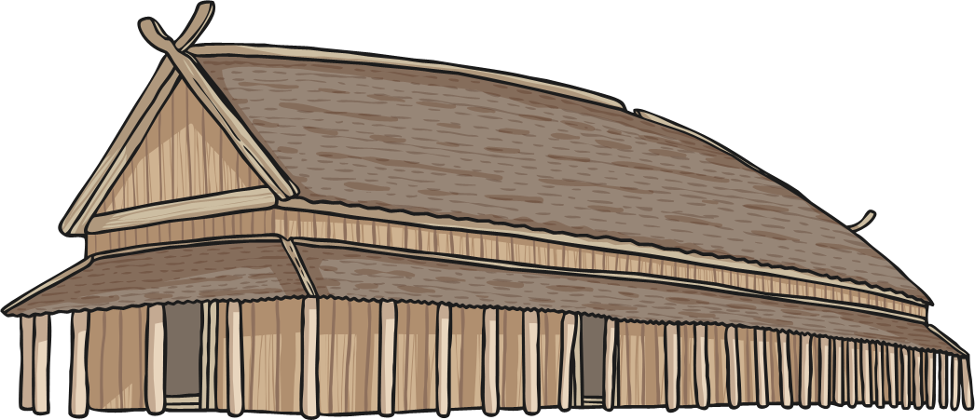
Viking Homes
Most Viking houses were made of wood, stone or turf with thatched roofs.
They all had a hole in the roof to let out smoke from the fire.
A fire was lit in the middle of the home for light and warmth.
A ‘smithy’ was a place to mend and make tools from iron.

Slide 3
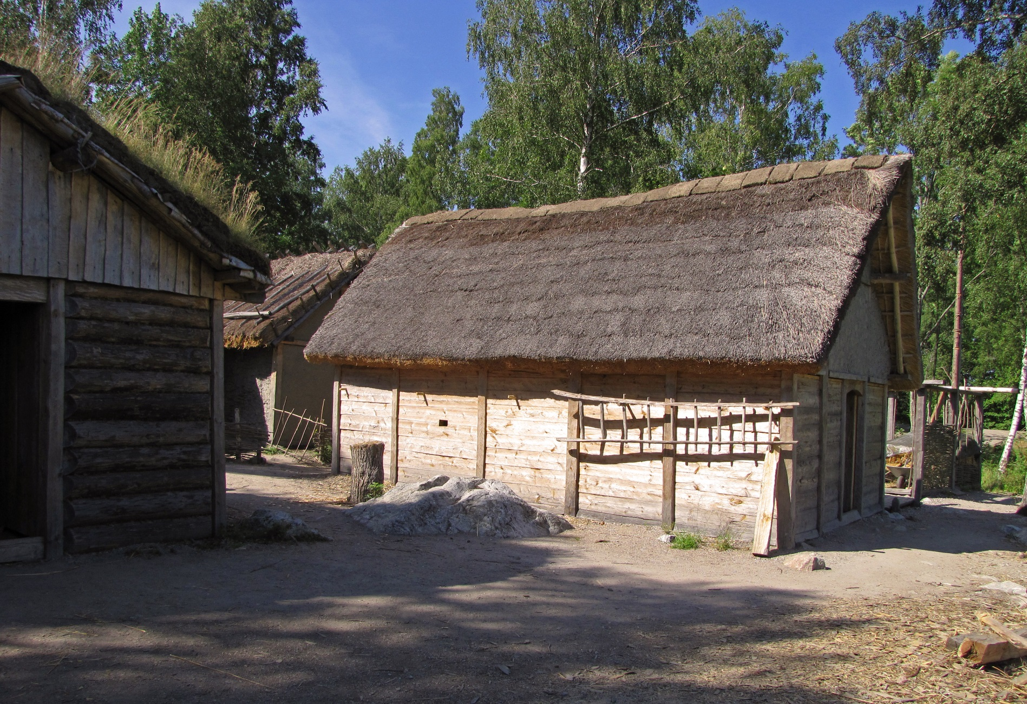
Photo courtesy of JsonLind(@flickr.com) - granted under creative commons licence - attribution

Slide 4
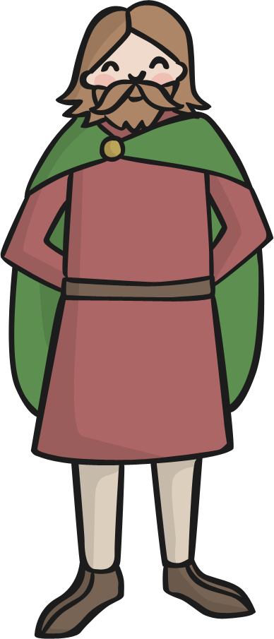
Viking Clothes - Men
Cloak
fastened with a pin or brooch.
Long Woollen Shirt
tightened with a sash or belt.
Long cloth Trousers
held up with sash or string.
Leather shoes
worn with socks.

Slide 5
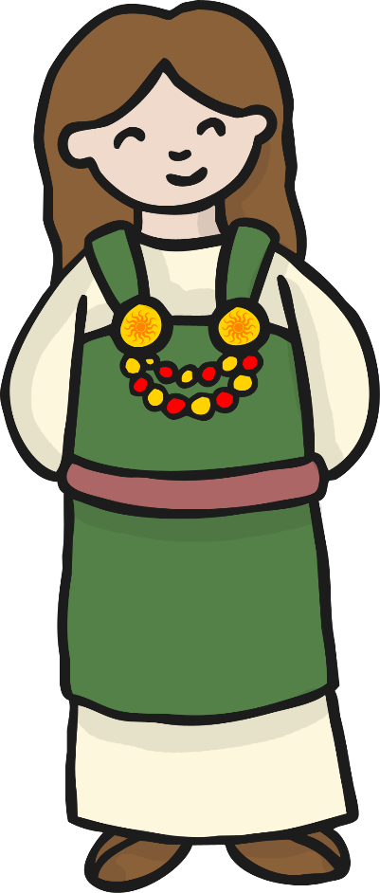
Viking Clothes - Women
Brooches
joined by beads and fastening the tunic.
Soft leather shoes
worn with thick socks.
Woollen tunic
Long linen dress

Slide 6
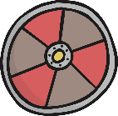
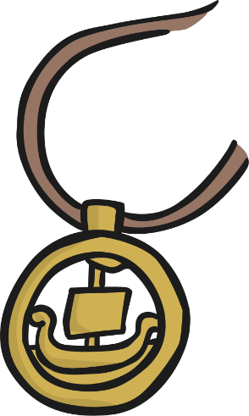
Jewellery
Men and women liked to wear jewellery. These could be rings, bracelets, necklaces and brooches.

Slide 7
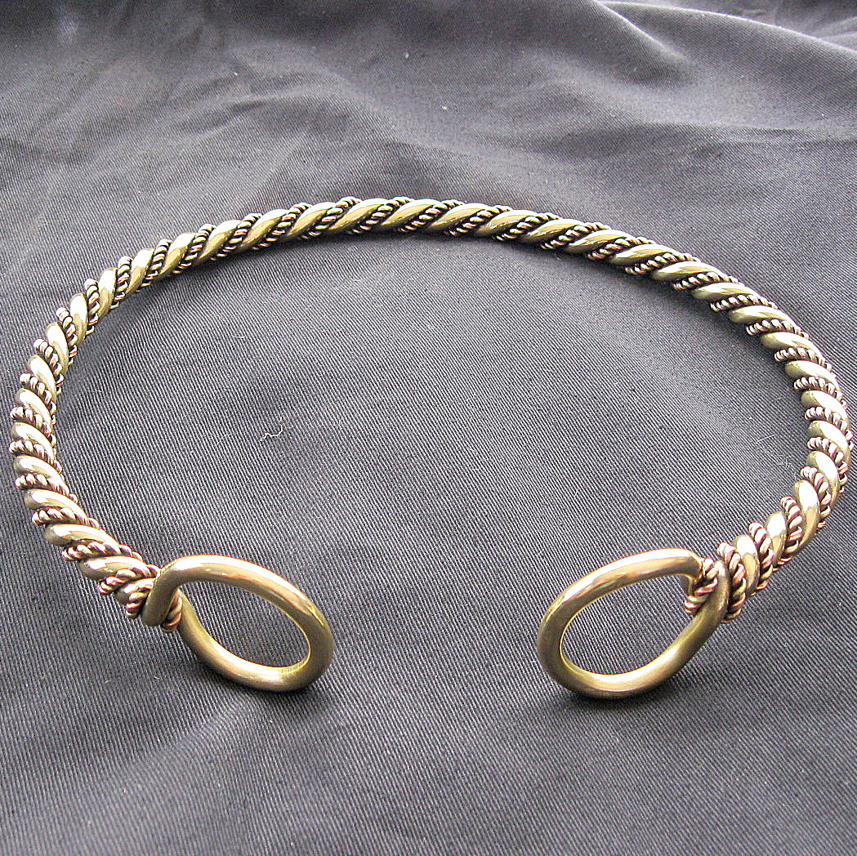
Photo courtesy of dad1_ (@flickr.com) - granted under creative commons licence - attribution

Slide 8
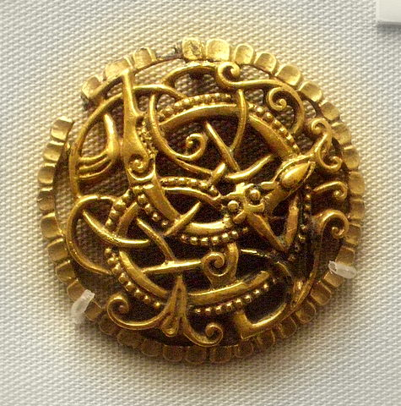
Photo courtesy of Kotomi_ (@flickr.com) - granted under creative commons licence - attribution

Slide 9
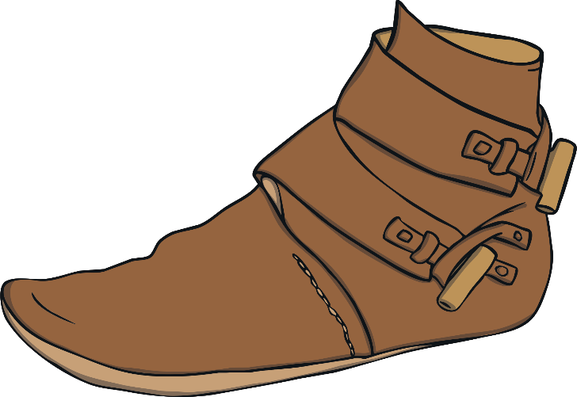
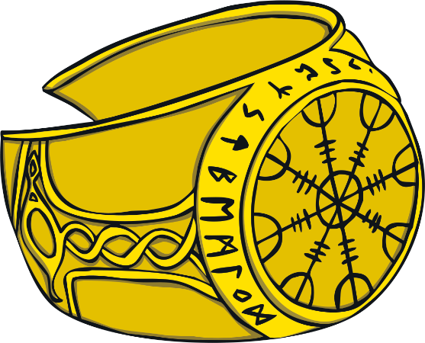
Viking Jobs/Life
There was no employment as such, during Viking times.
People were mostly farmers, craftsmen and traders.
Women milked cows to make cheese, spun, wove and sewed clothes.
Children did not go to school. Everything was learnt through stories.

Slide 10
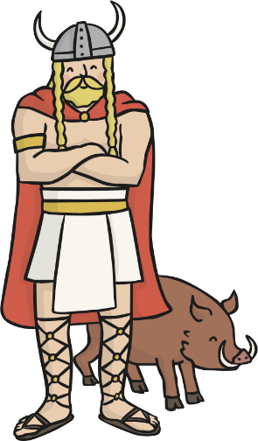
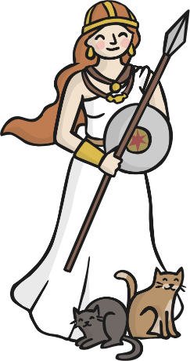
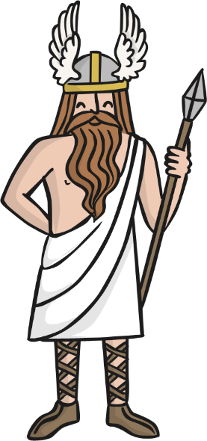
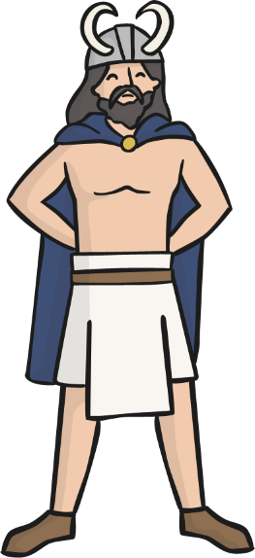
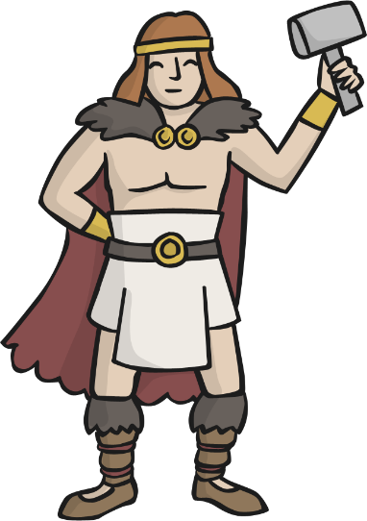
Viking Gods
Frey
Freyja
Odin
Thor
Loki

Slide 11
Viking Societal Ranks
Earls
and Chieftains
Freemen
(most people)
Slaves

