Slide 2
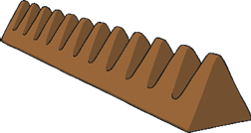
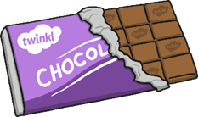
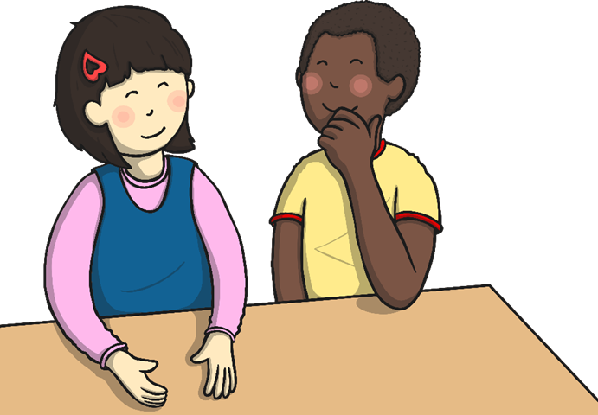
What Do You Know About Chocolate?
Discuss It!
Do you like chocolate?
Where do you think chocolate comes from?

Slide 3
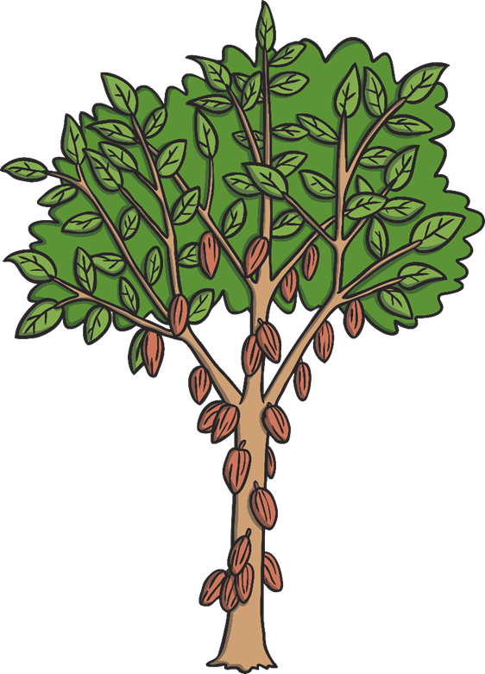
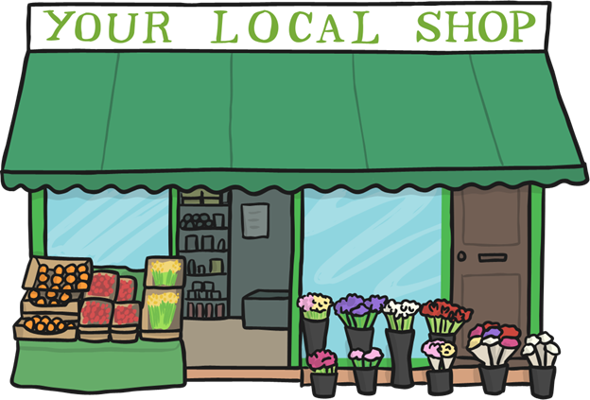
Does Chocolate Come from the Shop?
We buy chocolate from a shop but chocolate actually comes from cacao beans.

Slide 4
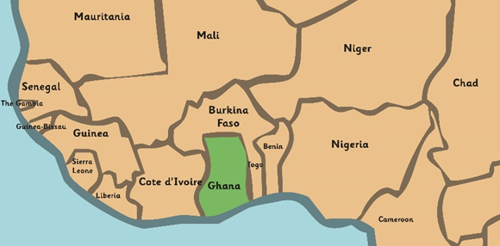
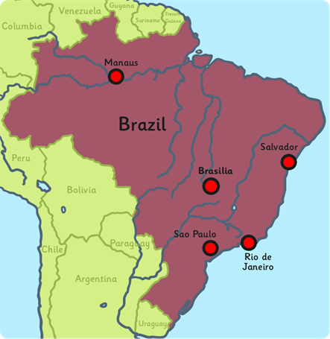
Where Does Chocolate Come From?
Chocolate comes from cacao pods.
Cacao pods grow on cacao trees.
Cacao trees are grown in large plantations, in hot places such as Brazil in South America and Ghana in West Africa.

Slide 5
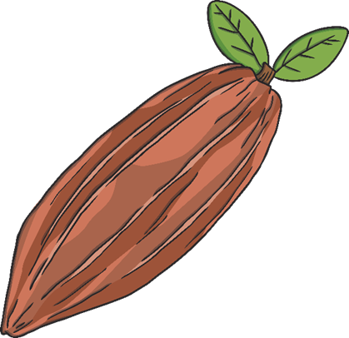
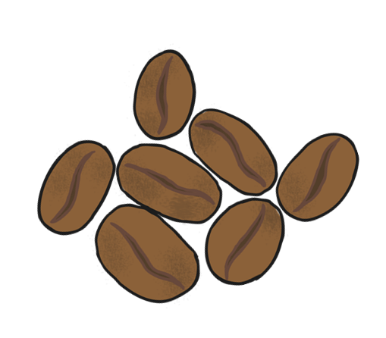
How Are Cacao Beans Harvested?
After six months of growing, the cacao pods are ripe and they are harvested.
The cacao pods are split open with a machete and the cacao beans are removed.

Slide 6
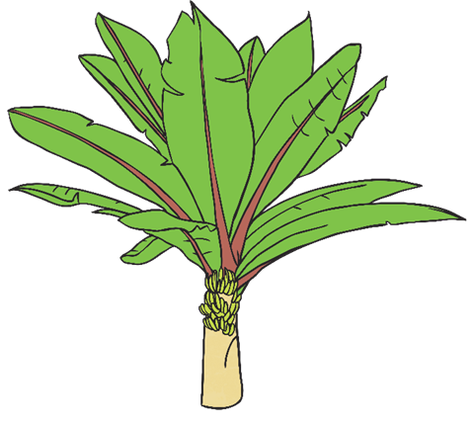
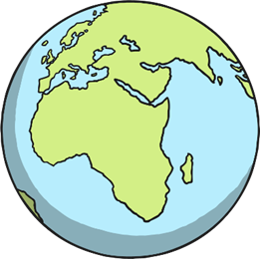
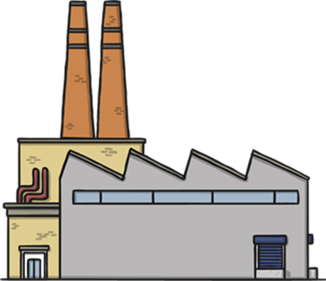
What Happens to the Cacao Beans?
The beans are covered with banana leaves and left to dry out in the sun for about a week.
The beans are shipped out to chocolate factories all over the world.

Slide 7
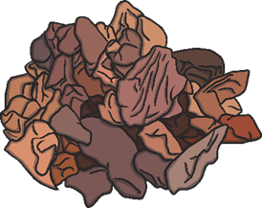
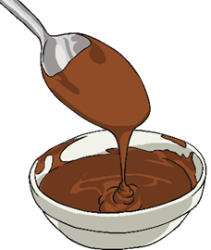
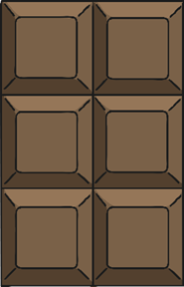
How Is Chocolate Made from Cacao Beans?
In factories, the beans are cleaned and then roasted.
The shells are cracked and removed and you are left with broken pieces of cacao, called ‘nibs’.
The nibs are then ground into a thick paste.
Other ingredients, such as sugar, cocoa butter and milk are added to make the chocolate taste nice.
The chocolate is poured into a mould and left to set.
The chocolate is packaged and sent to shops to be sold.
Watch it!
Watch this clip to see how chocolate is produced in a factory.
*NB. Please check the content in this link, including any comments, is suitable for your educational environment before showing.

Slide 8
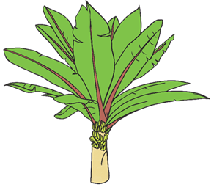
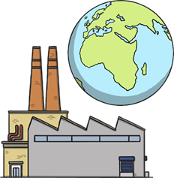
Do it!
Can you put the pictures in order to show where chocolate comes from?
1 | 2 | 3 | 4 | 5

Slide 9
Oh no!
Click here to try again.

Slide 10
Do it!
Can you put the pictures in order to show where chocolate comes from?
1 | 2 | 3 | 4 | 5

Slide 11
Oh no!
Click here to try again.

Slide 12
Do it!
Can you put the pictures in order to show where chocolate comes from?
1 |  | 3 | 4 | 5

Slide 13
Oh no!
Click here to try again.

Slide 14
Do it!
Can you put the pictures in order to show where chocolate comes from?
1 |  |  | 4 | 5

Slide 15
Oh no!
Click here to try again.

Slide 16
Do it!
Can you put the pictures in order to show where chocolate comes from?
1 |  |  |  | 5

Slide 17
Oh no!
Click here to try again.

Slide 18
Do it!
Can you put the pictures in order to show where chocolate comes from?
1
Correct – Well Done!

Slide 19
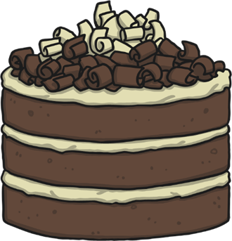
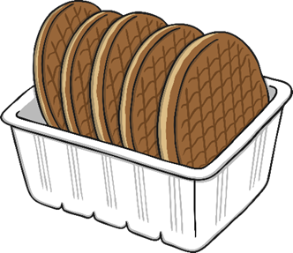
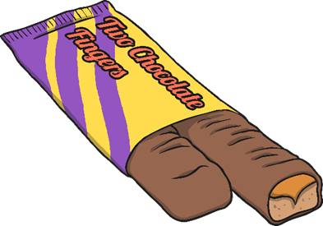
What Is Chocolate Used For?
Chocolate is used to make lots of delicious foods and drinks.
Discuss It!
Which is your favourite kind of chocolate?

Slide 20
Glossary
harvested - when crops are collected
paste - a thick, soft, sticky substance
machete - a large, heavy knife
plantations - a large group of plants and trees
ripe - ready to be used or eaten
nibs - crushed cacao beans
mould - a hollow container used to give shape to liquid when it cools and hardens

